Slide 1
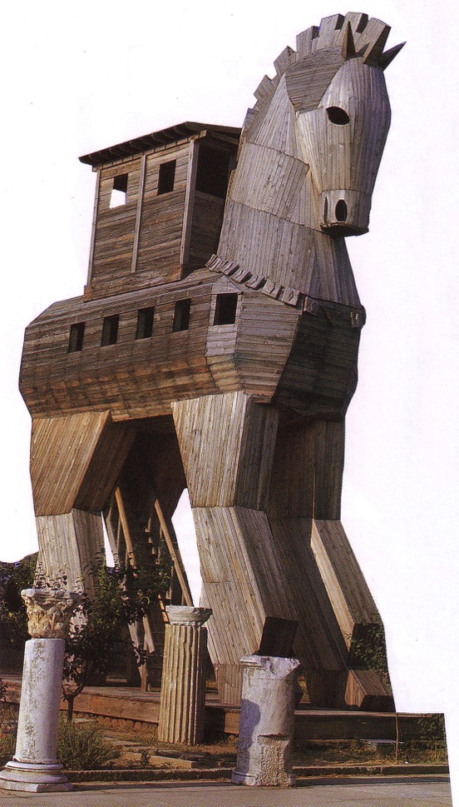
Intertestamental Geography
8
Dr. Rick Griffith • Jordan Evangelical Theological Seminary • BibleStudyDownloads.org

Slide 2

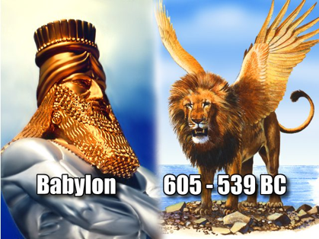
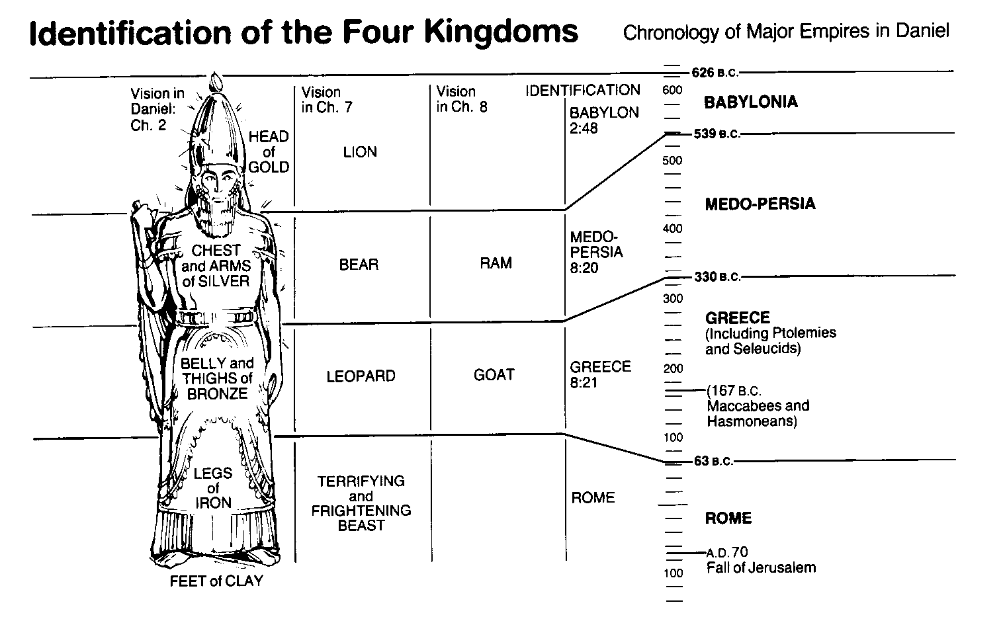
World Empires in Daniel
OTS 545
Bible Visual Resource Book, 133

Slide 3

Greek Rule over Palestine
Alexander
Struggle for Supremacy
Hellenistic Empire Developments

Slide 4
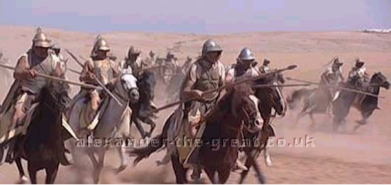
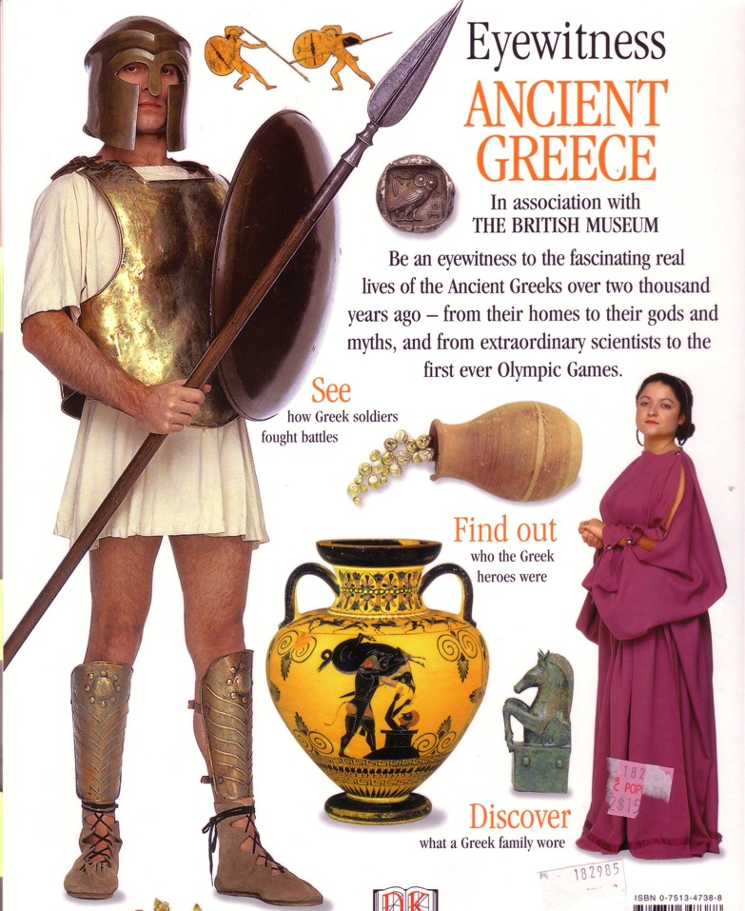
What was so Great about Alexander?
60
Colonization (Hellenization)
Conquest
Consolidation (Greek Language)

Slide 5
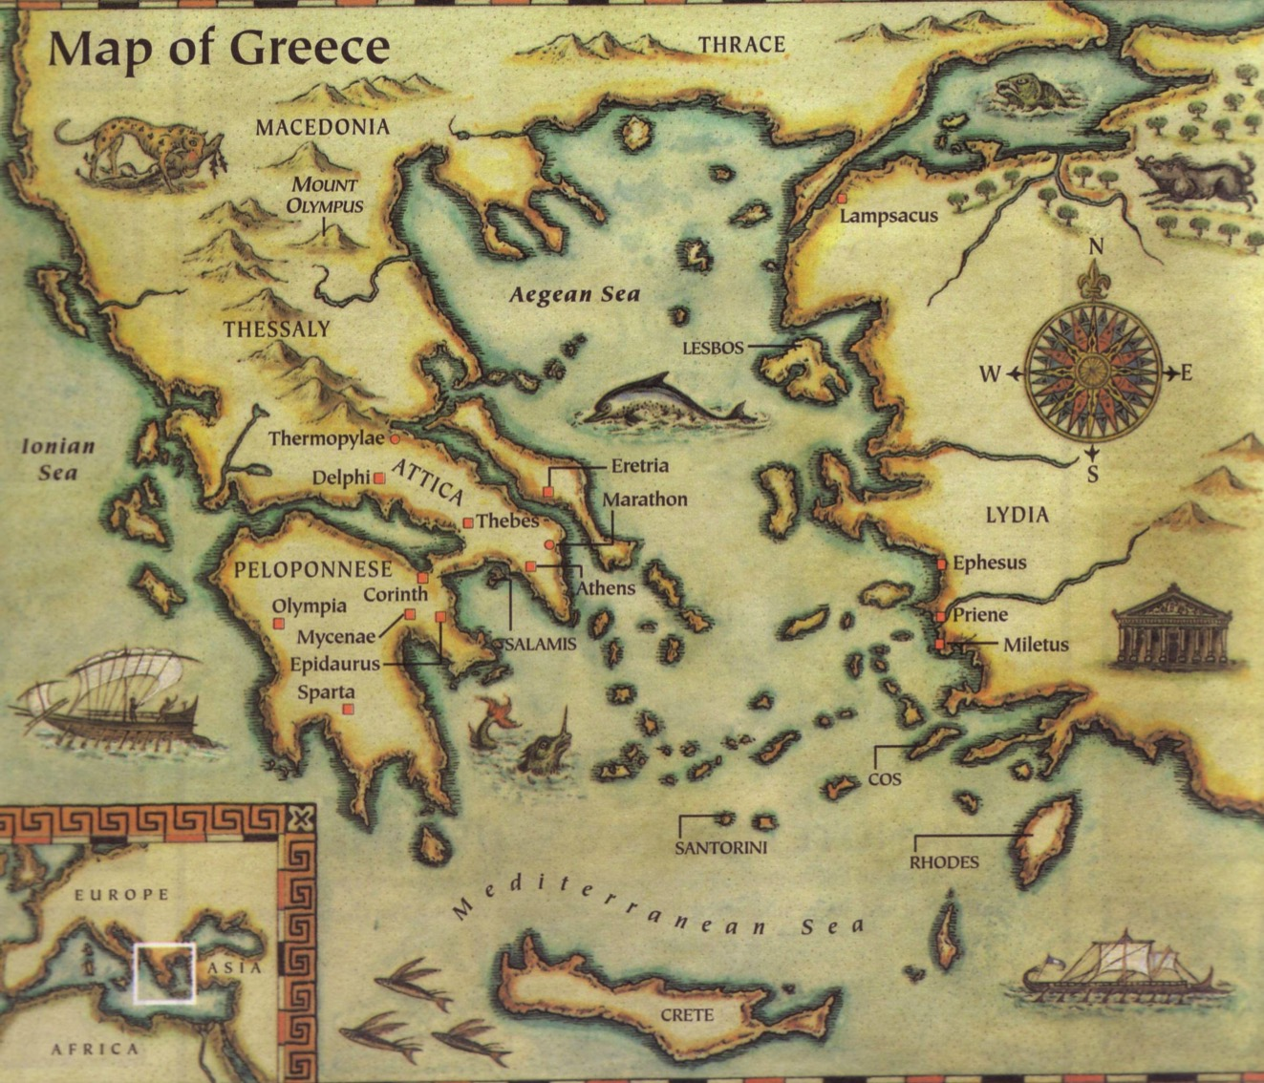

Slide 6
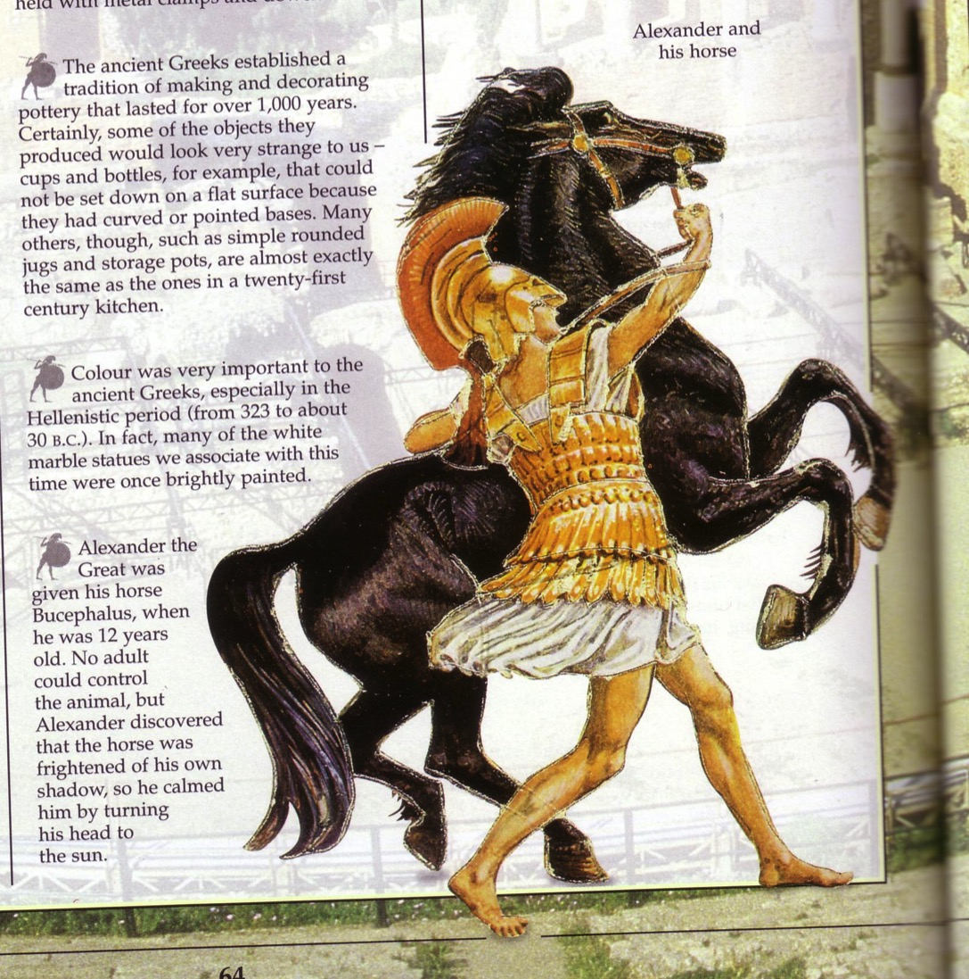
Alexander & His Horse

Slide 7

Alexander Made Headlines…

Slide 8
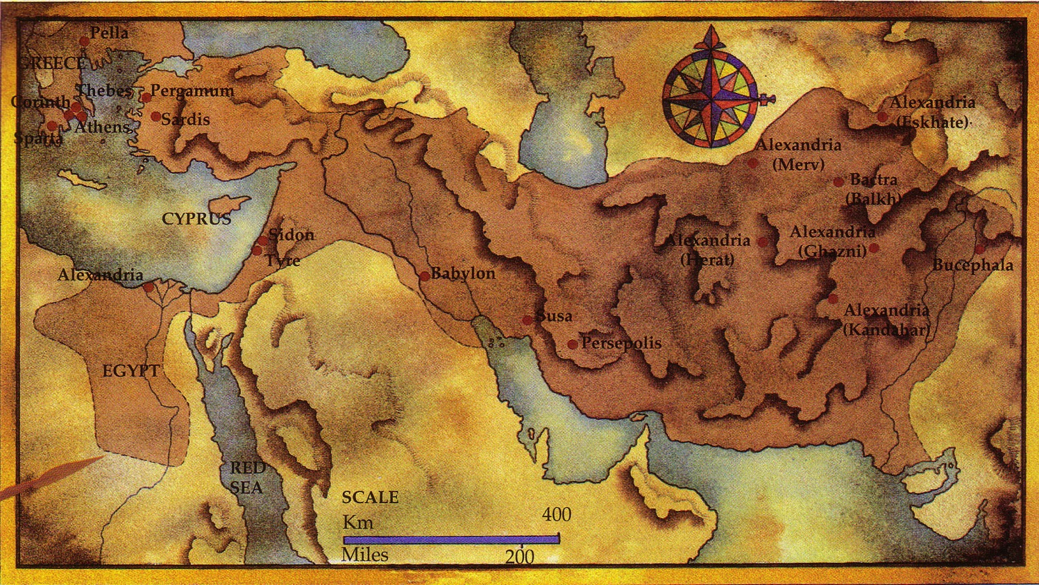
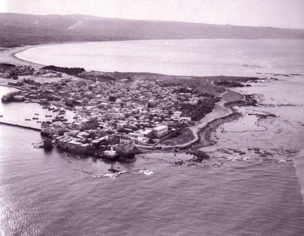
Alexander’s Conquests
25

Slide 9
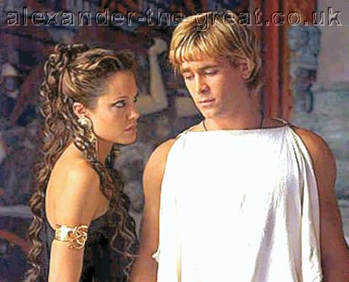
His Downfall
Due to Pride:
Desire for worship
Wine
Women
Song

Slide 10
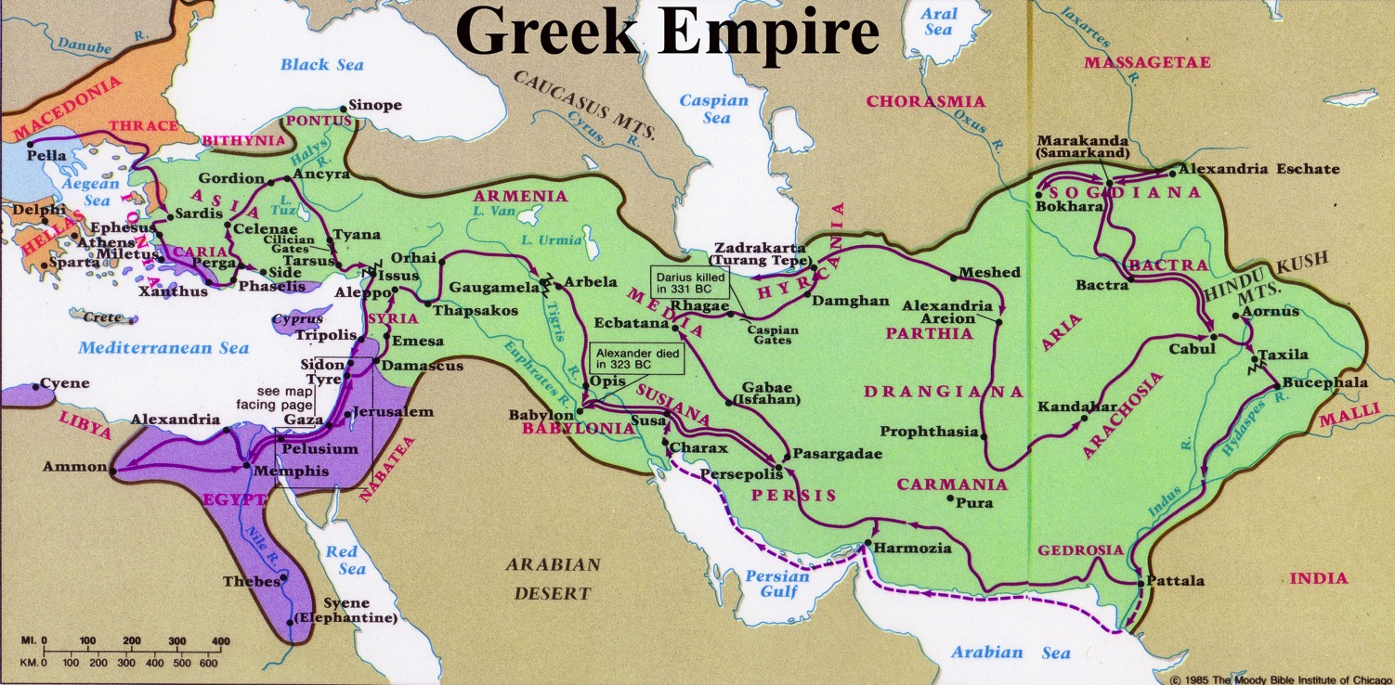
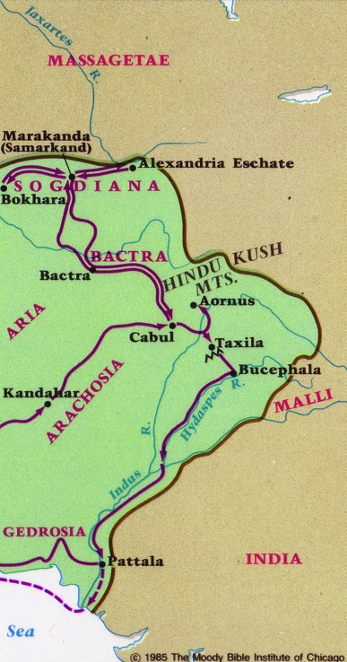
After Alexander…
26
Cassander
Lysimacus
Seleucus
Ptolemy
"And the he-goat is the king of Greece; and the great horn between his eyes is the first king. As for the horn that was broken, in place of which four others arose, four kingdoms shall arise from his nation but not with his power" (Daniel 8:21-22 RSV)

Slide 11
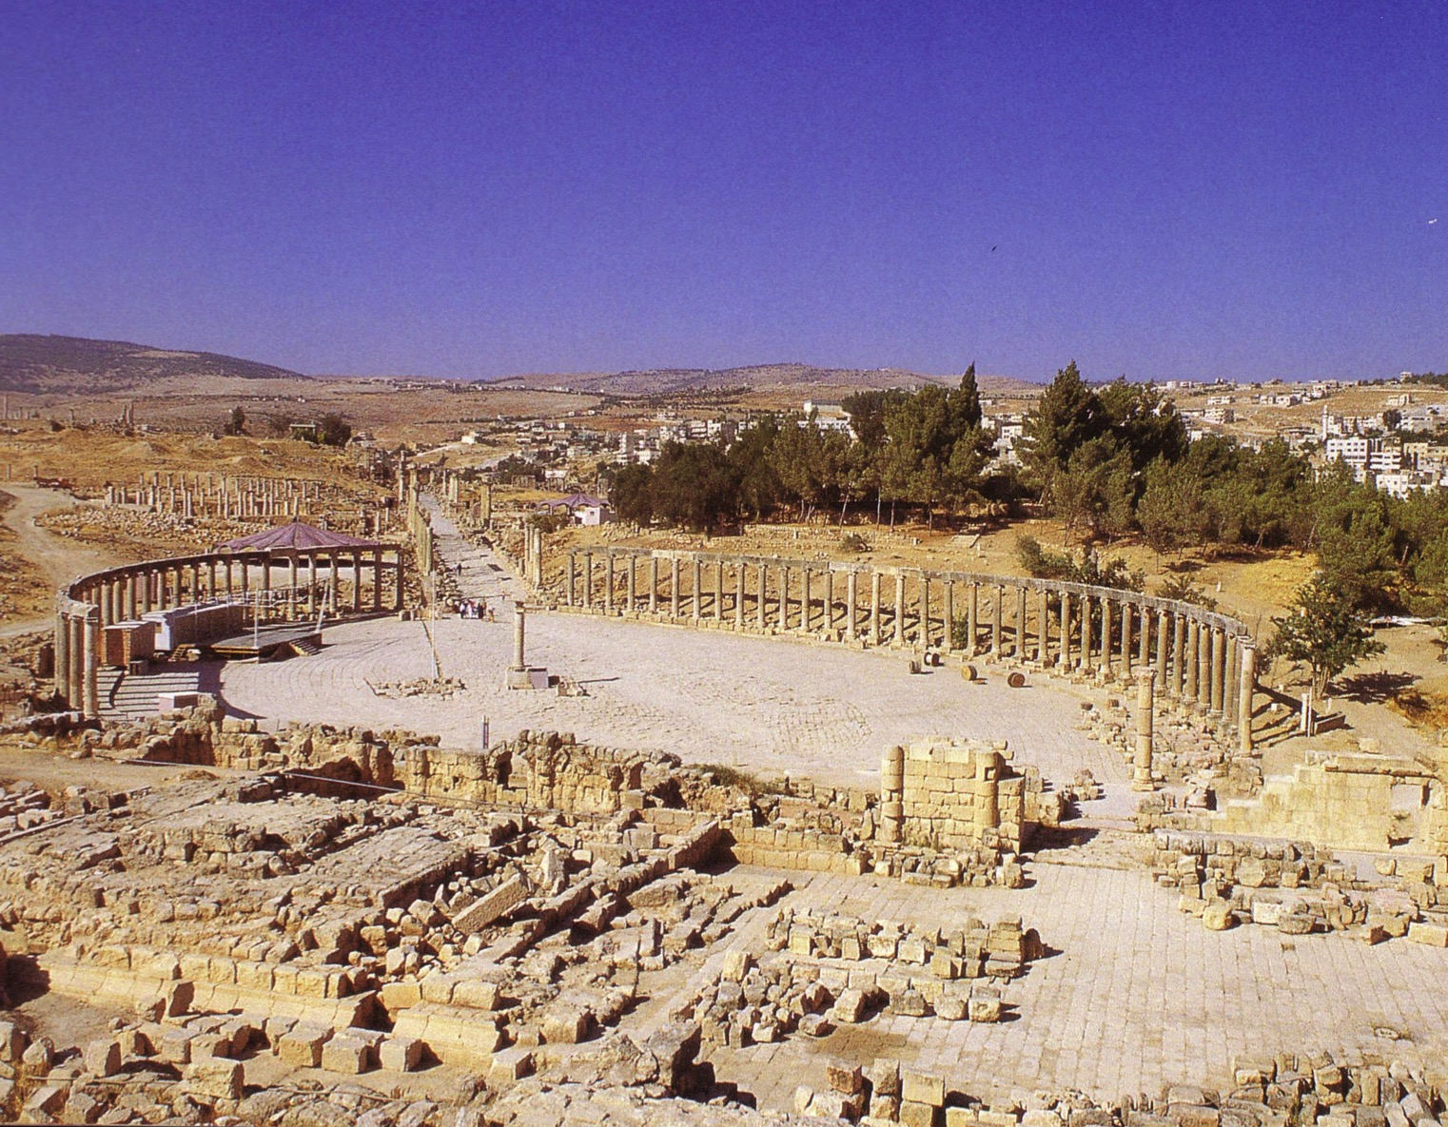
Jerash of the Decapolis

Slide 12
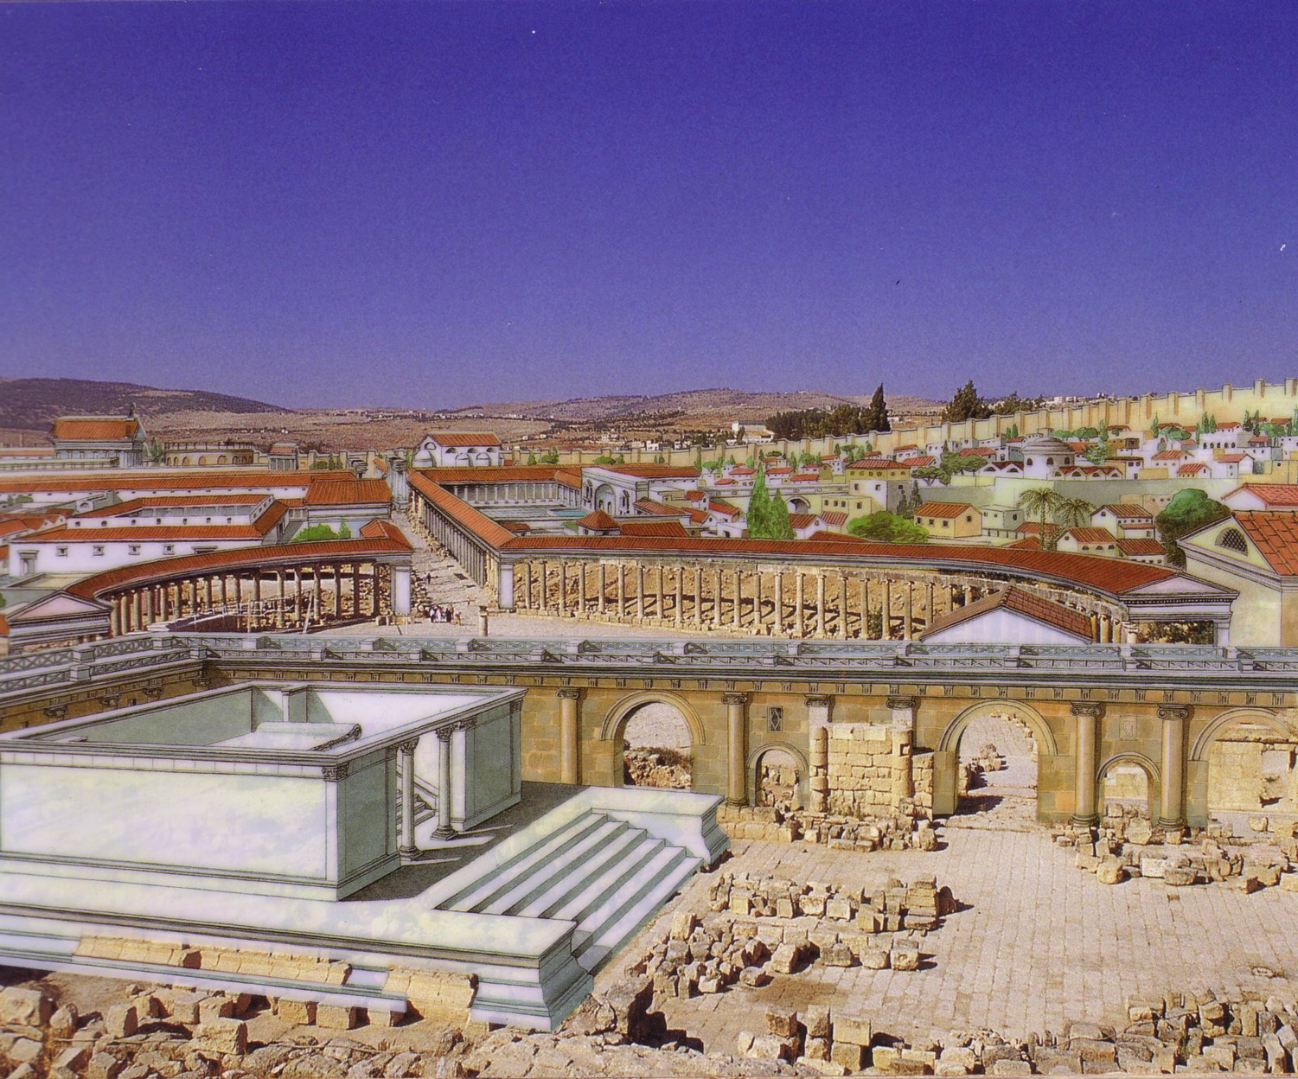
Jerash in Its Glory Days

Slide 13
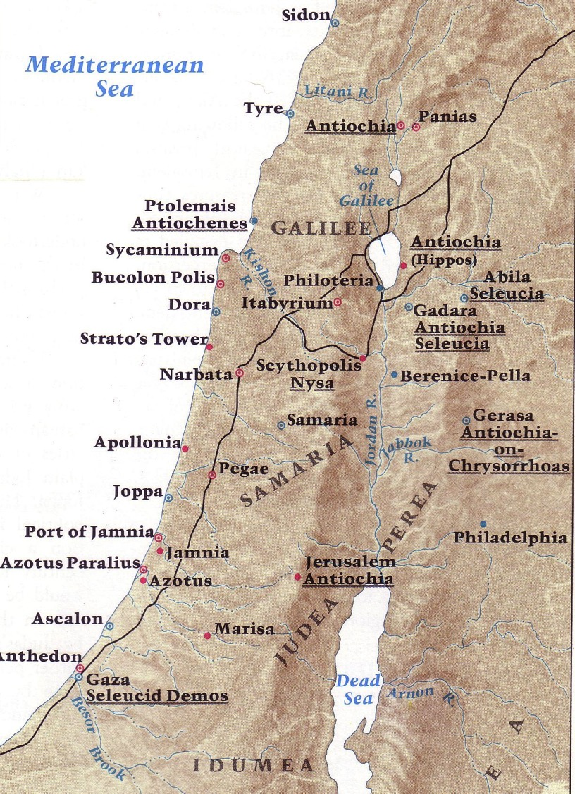
Greek Cities in Palestine
180

Slide 14
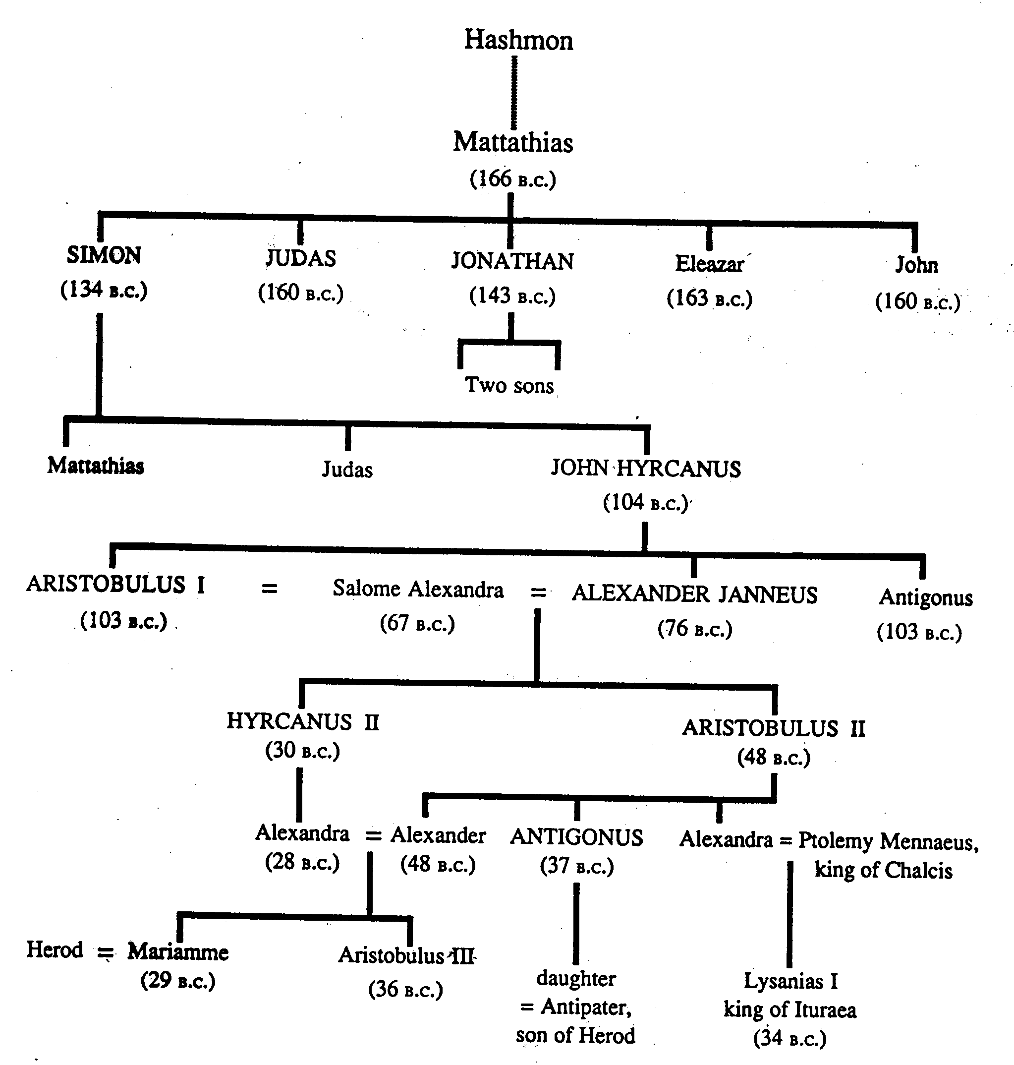
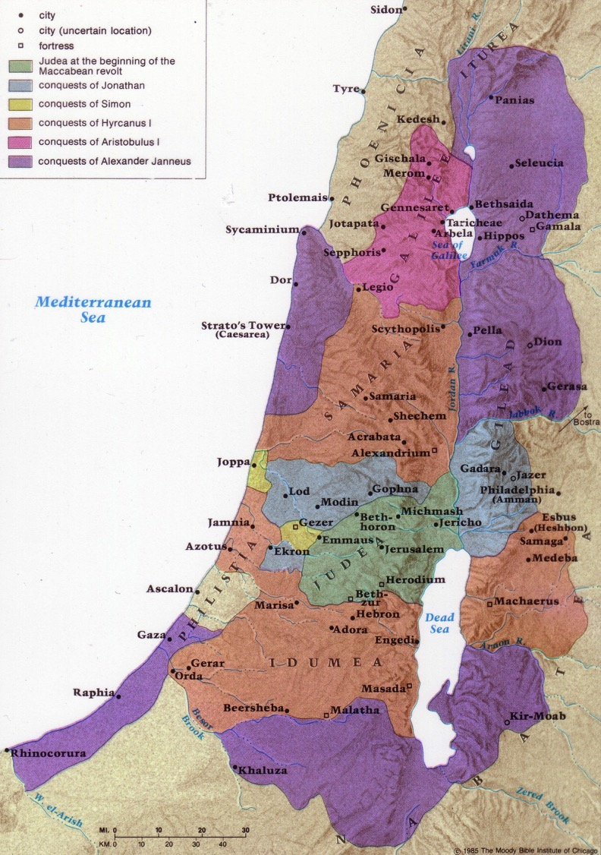
Hasmonean Expansion
174
?
?

Slide 15
Greek Era Significance
188
Ptolemaic (301-198)
Seleucid (198-143)
Religious Freedom
Rise of Sanhedrin
Hellenization
Alexandria Migration
Greek Language/LXX
High Priesthood
Rise of Hasidim
Temple desecration
Maccabean Revolt
Rise of Sadducees

Slide 16
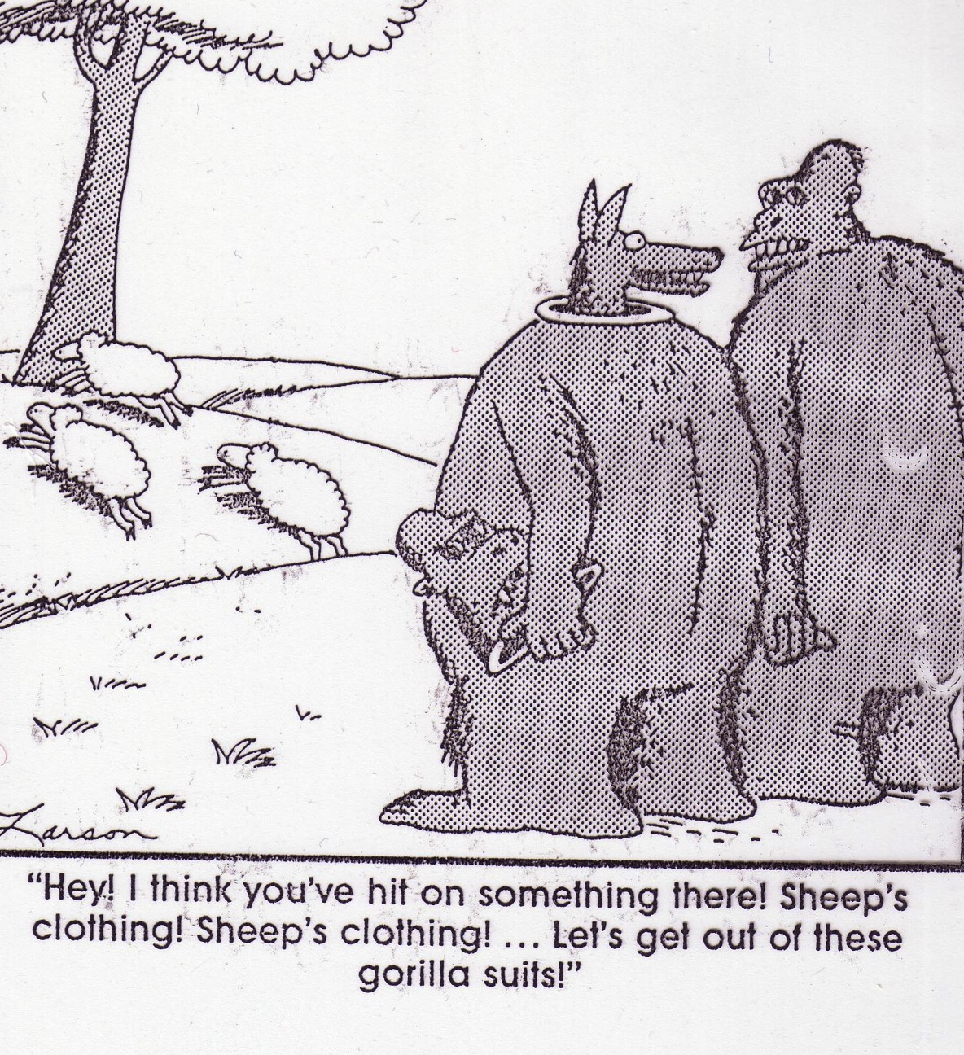
“Hey! I think you’ve hit on something there! Sheep’s clothing! . . . Let’s get out of these gorilla suits!”

Slide 17
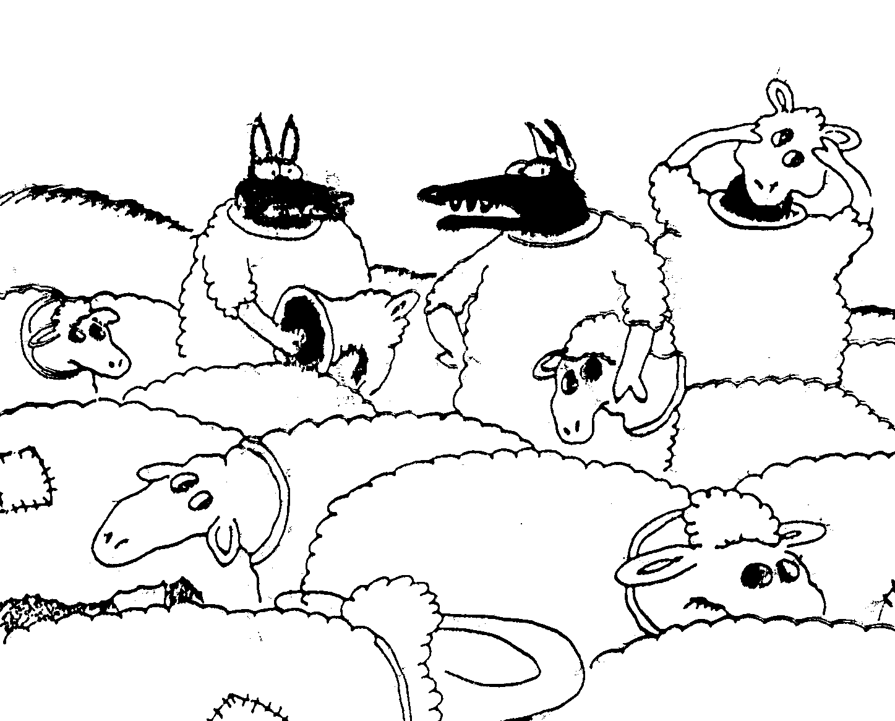
“Wait a minute! Isn’t anyone here a real sheep?”

Slide 18
Hasmonean Significance
188
Religious Independence (Pharisees)
Hanukkah (Feast of Lights)
Political Independence (Judas, Sadducees)
Priest & King in One Person (Jonathan)
Rise of Essenes (Simon)
Expansion of Borders
Alliance with Rome
Enforced Judaism
John Hyrcanus

Slide 19



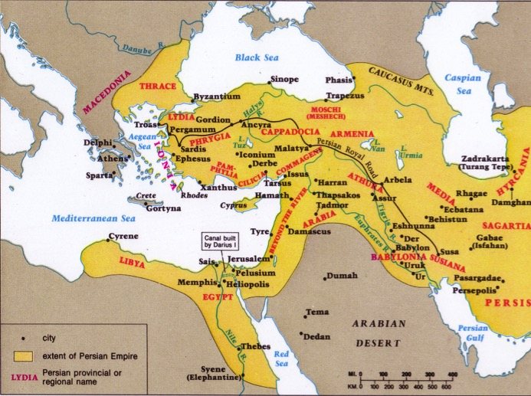
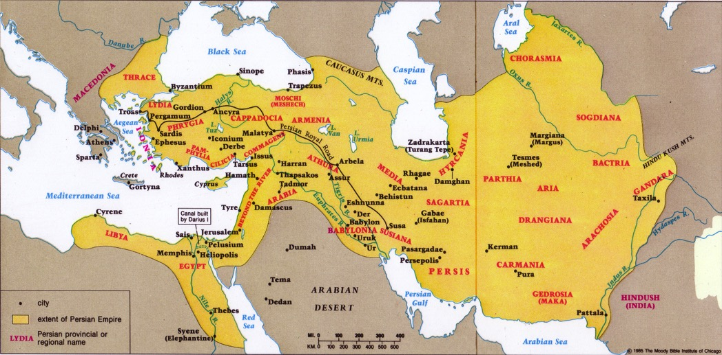
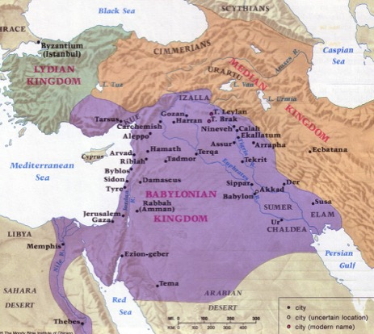
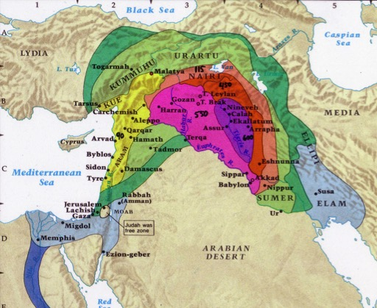
Intertestamental Empires
26

Slide 20
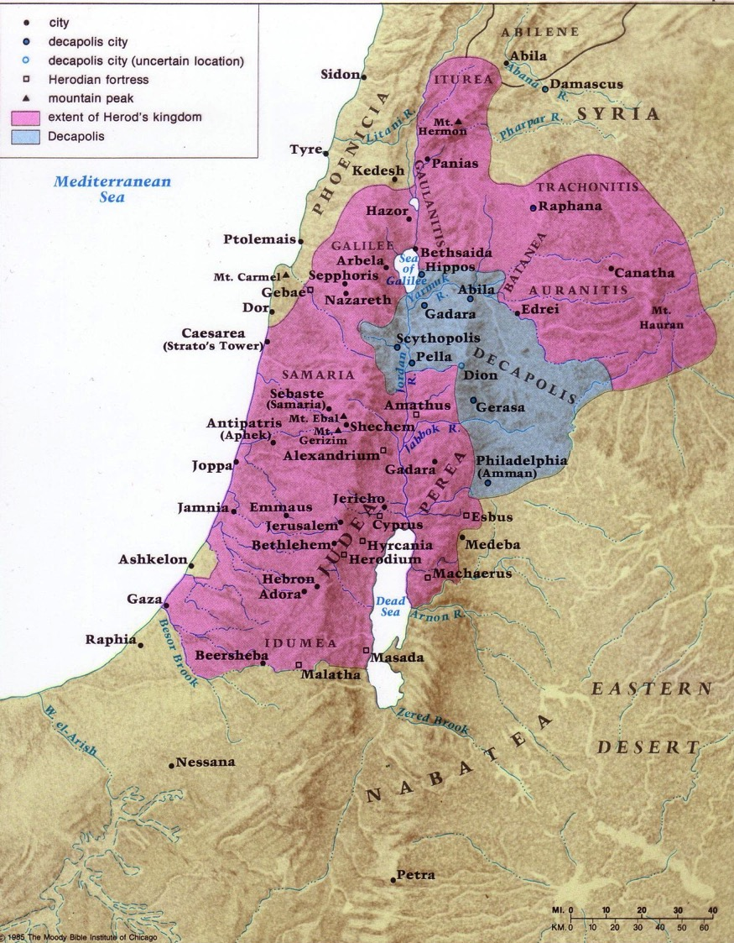
Palestine under Herod the Great
180

Slide 21
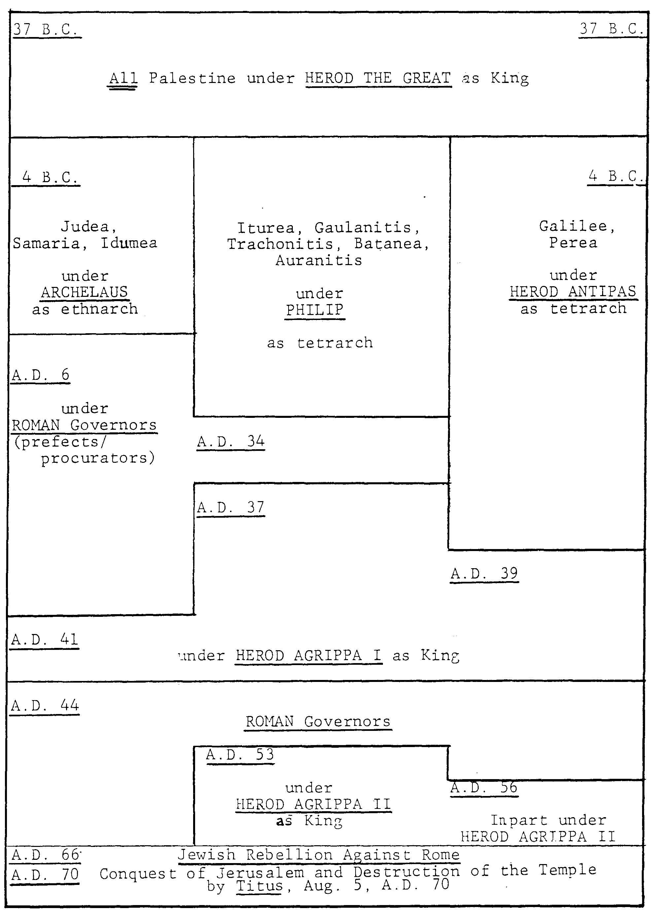
Chronology of the
Herodian Dynasty
(37 BC-AD 70)
181
Archelaus
Philip
Antipas
Romans
Agrippa I
Romans
John Grassmick,
Dallas Seminary
Agrippa II

Slide 22
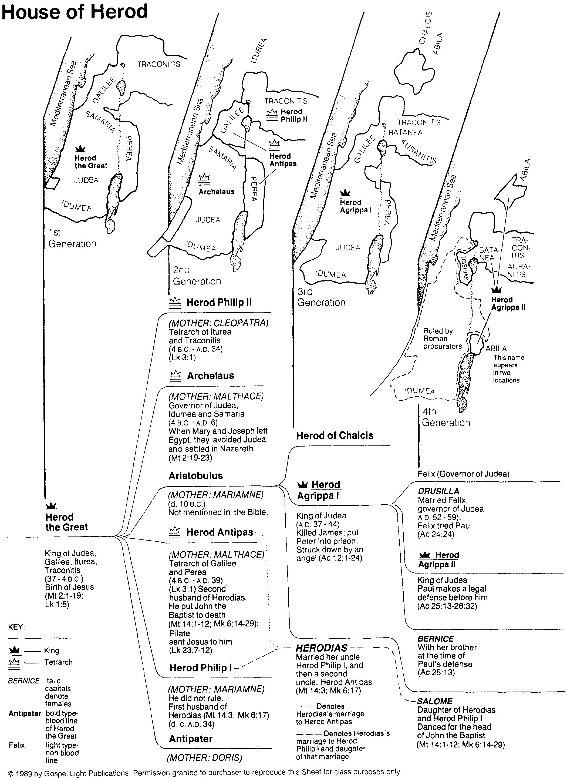
Geography of the House of Herod
182
Bible Visual Resource Book, 181

Slide 23
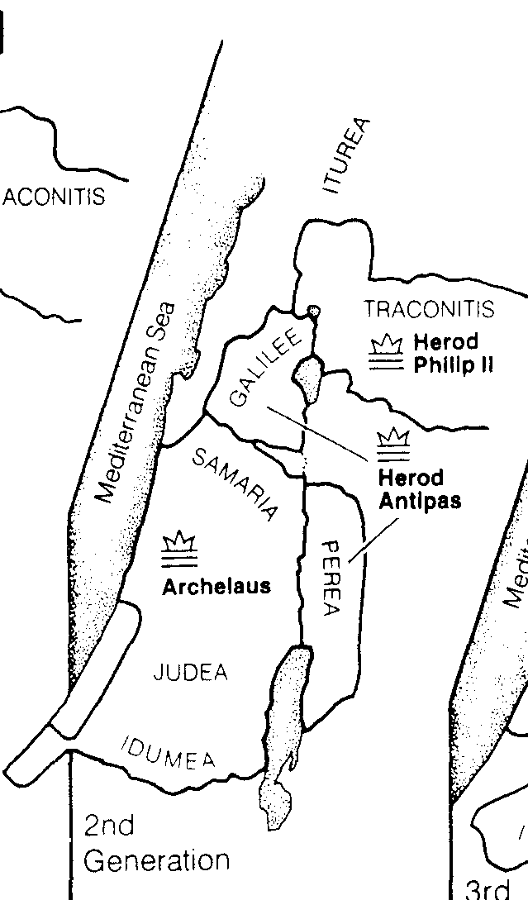
Herod’s Three Ruling Sons
181
Philip
Antipas
Archelaus
Bible Visual Resource Book, 181

Slide 24
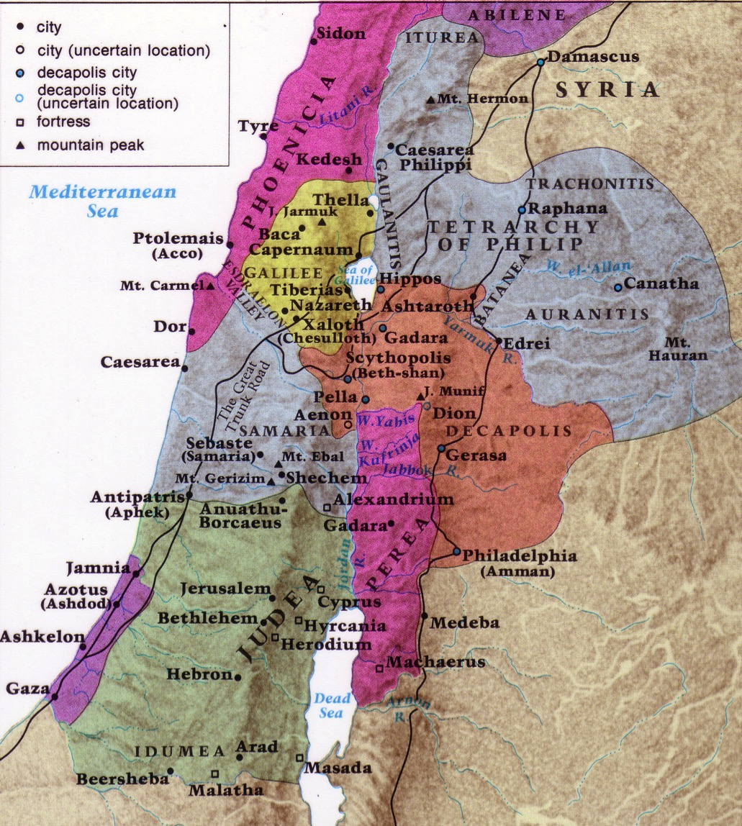
NT Boundaries in Israel
180

Slide 25

THANK YOU
By Samuel and Michael

Slide 26
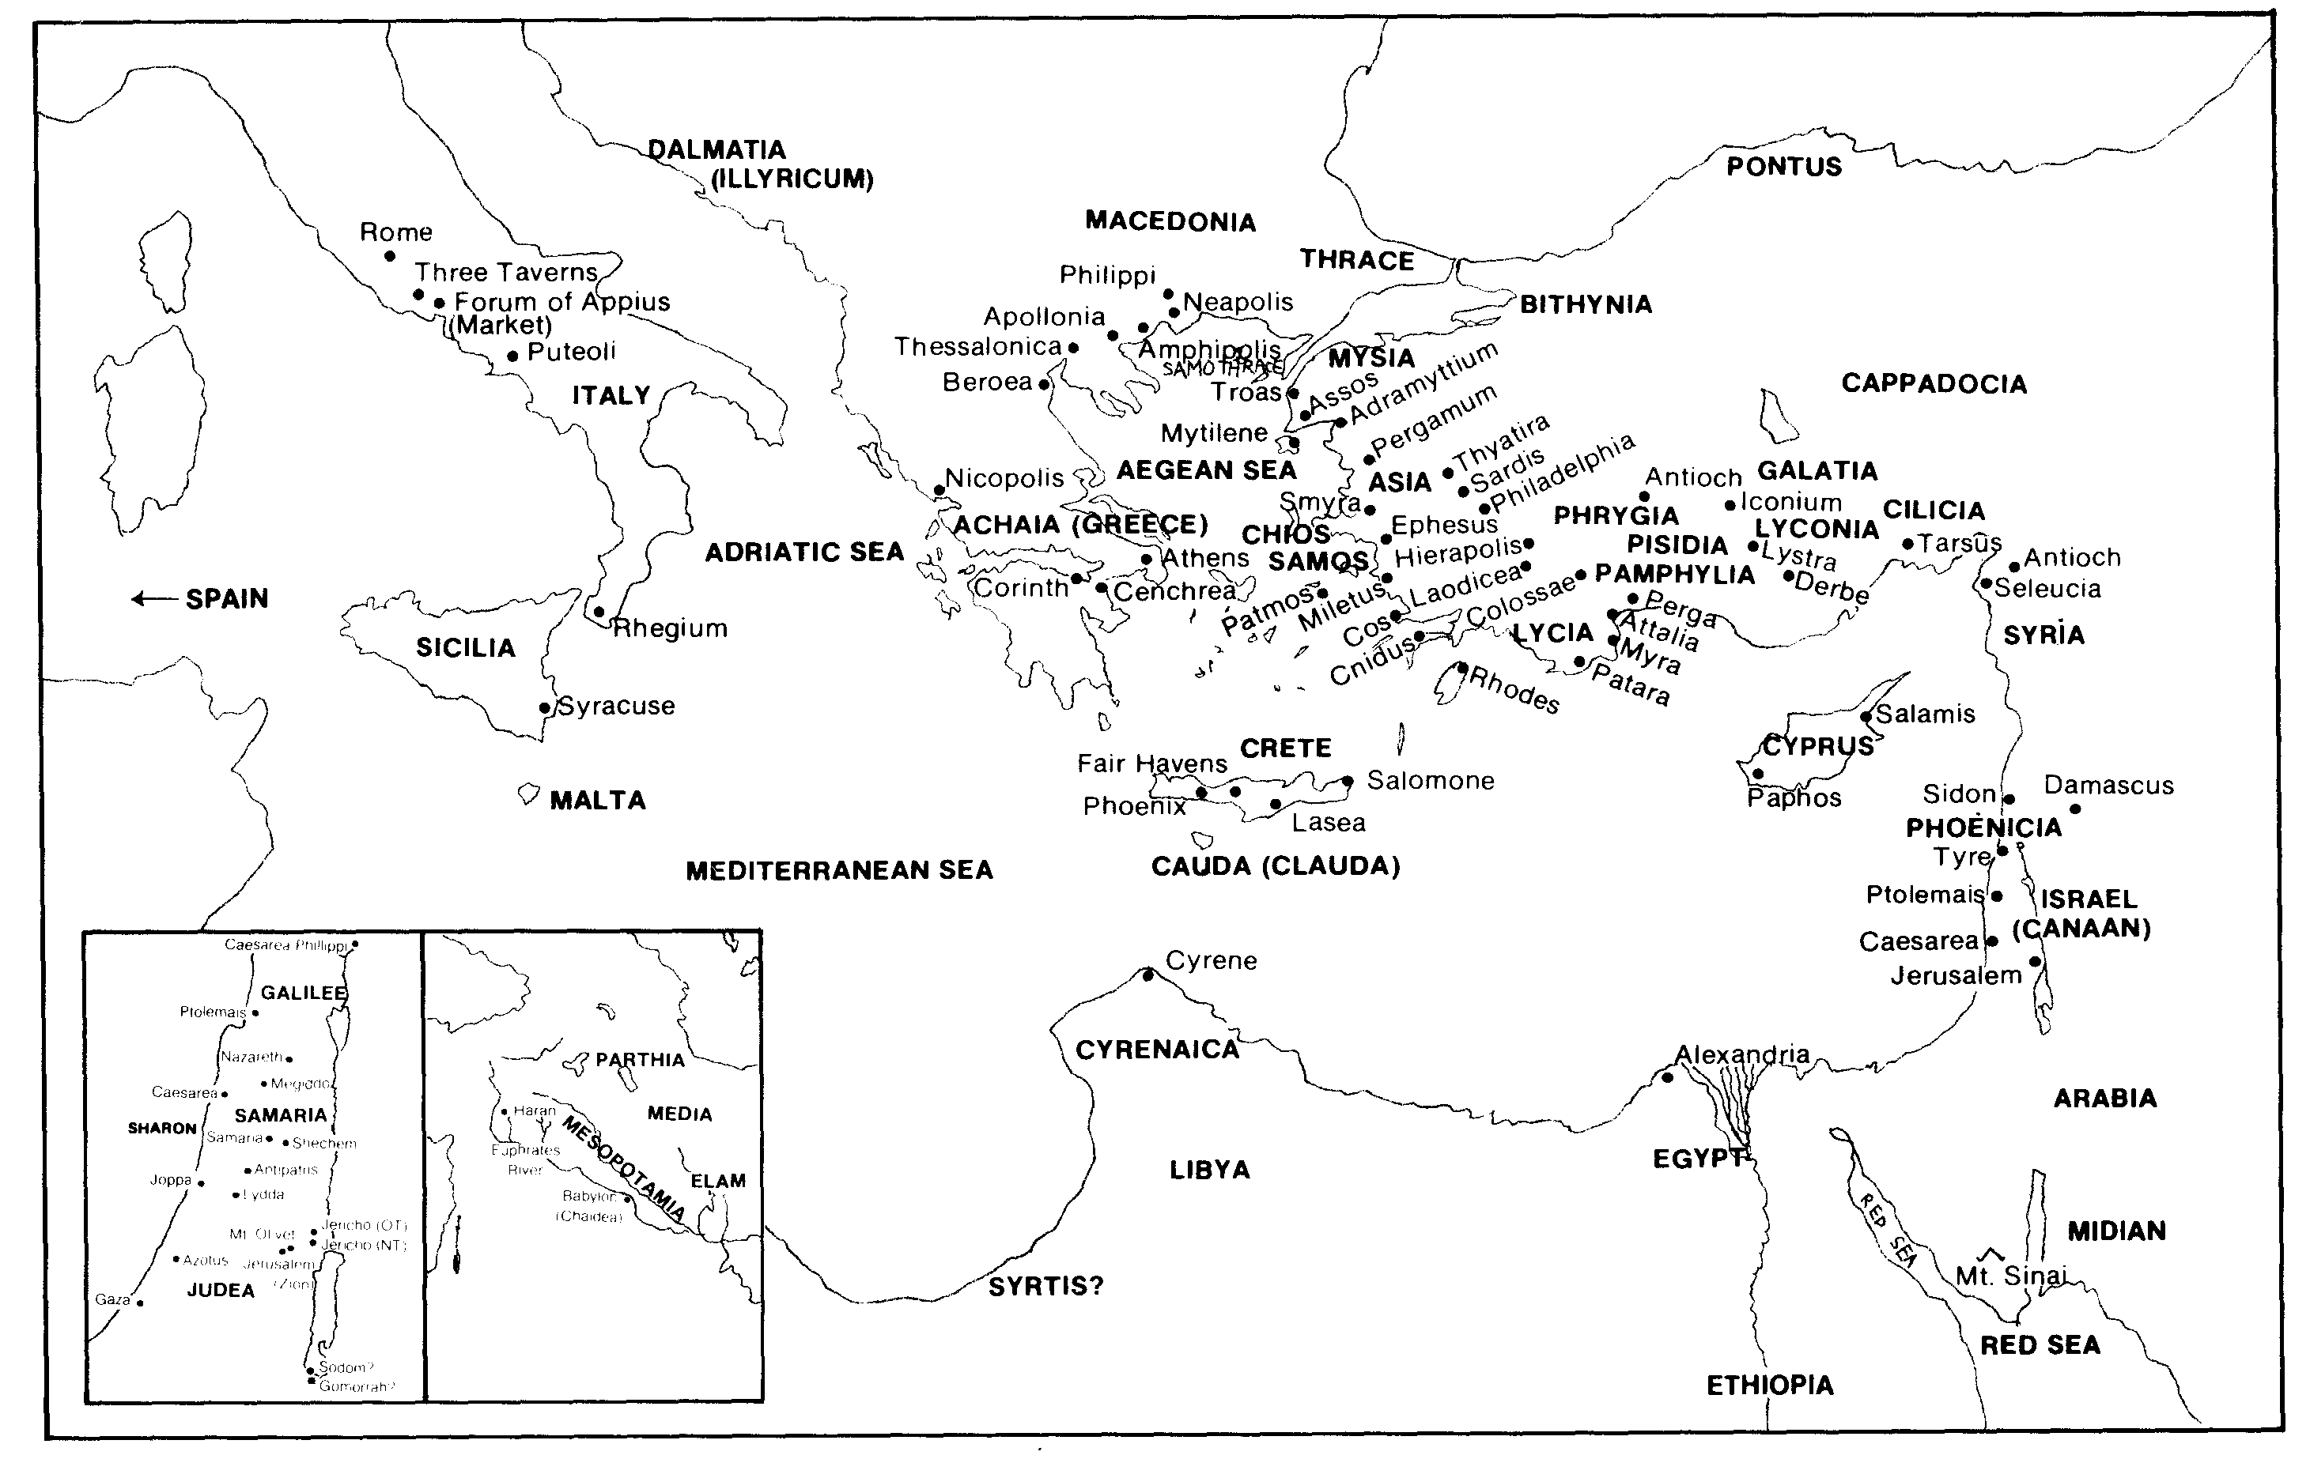
Every Geographical Location in Acts / Epistles (Quiz #3)
30

Slide 27
Black

Slide 28


Bible Geography link at BibleStudyDownloads.org
Get this presentation for free!
Notes:
Bible Geograhpy (bg)

